Slide 1

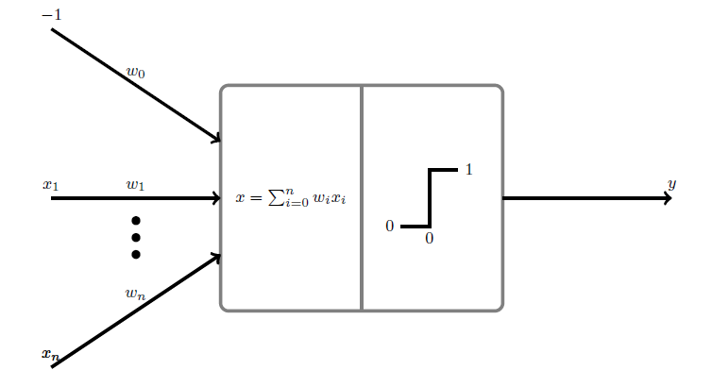
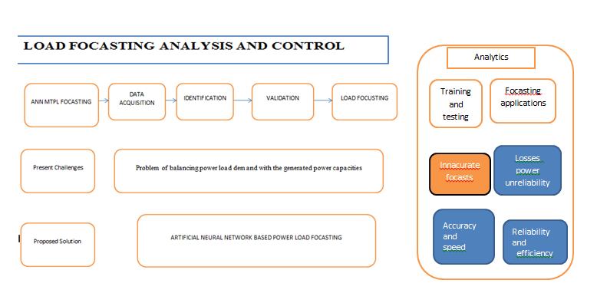
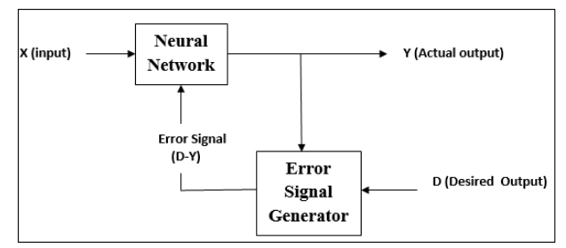
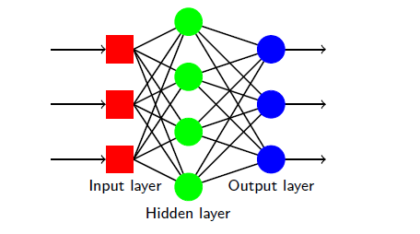
Artificial Neural Networks Based Power Load Forecasting.
Mr. Francis Komen and Dr. Thiga Moses
Kabarak University
B. IDENTIFICATION
The most important parameters of the model are identified. The parameters include historical electric load, G.D.P, housing, weather data etc
Fig 3.
Multilayer perceptron (MLPS)
MLPS are feed forward neural networks.
Organized in layers:
  One input layer of distribution points
  One or more hidden layers of artificial neurons (nodes)
  One output layer of artificial neurons (nodes).
  Each node in a layer is connected to all other nodes in the next layer.
  Each connection has a weight (remember that the weight can be zero).
MLPs are universal approximators
C .VALIDATION/TRAINING
The model is trained by applying all inputs to the network before the weights and biases are updated. Incremental training mode will be applied. The load forecasted will be compared with the actual load data and the error will be calculated using statistical indices e.g. Mean Absolute error, Correlation Coefficient-, Root Mean Square- The performance of the model is checked if it does not conform, then the model will have to be re-evaluated and either additional parameter will have to be added so that better accuracy can be achieved.
Fig 4.
Supervised learning.
Send the MLP an input pattern from the training set.
Get the output from the MLP as y.
Compare y with the target t,to get the error quantity.
Use the error quantity to modify to modify the weights, next time y will be close to t.
Repeat with another x from the training set.
Generalization is used when updating weights with accuracy.
MLPs perceptron learning rule.
It minimizes the difference between the actual and the desired outputs. It applies the mean square error (MSE) to tell us how good the error is.Learning aims to minimize the error by adjusting the weights.
Perceptron
It employs supervised learning rule and is able to classify the data into two classes.
It consists of a single neuron with an arbitrary number of inputs along with adjustable weights, but the output of the neuron is 1 or 0 depending upon the threshold. It also consists of a bias whose weight is always 1.
Following figure gives a schematic representation of the perceptron.
1.0 INTRODUCTION
Load forecasting is the prediction of the load behavior for a certain period of time. Load or energy forecast is important for determination of power generation capacity, transmission and distribution. Precise load forecasting helps electric utility company make unit commitment decisions, reduce spinning reserve capacity and schedule device maintenance plan properly. (Jingfei Yang, 2006).Power utilities companies face challenges in power system operation due to power flow dynamics of varying system loads, machine characteristics and operation.
Research qualifies Artificial neural networks (ANN) as intensive methods of computation to find patterns in data sets that are very large, it also contains many explanatory variables that standard method like multiple regression is impractical thus ANN provides accurate load forecasts.
2.0 Problem
There is a big problem of determining and balancing actual load demand with the generated power capacities. There is dire need for countries across the world to carry out continuous load forecasting assessment for adequate management and optimization of their scarce power resources and improve power reliability while maximizing on profits .
3.0 Current solutions.
In Kenya Load forecasts are done using econometric models which depend on the accuracy of the factors which influence the power demand and only works better for a larger geographical area compared with smaller areas. This models often lead underestimates or overestimates which lead to unnecessary expensive investments that are underutilized
4.0 PROBLEM AND PROPOSED SOLUTION SUMMARY
Fig 1.
METHODOLOGY.
A .MODEL FORMULATION
The network parameters for the model are determined. The model will be trained using arbitrary designed structure. A network structure with appropriate number of hidden layers of neurons and one output neuron. Choice of momentum factor and learning rate and held constant throughout the training.
Fig 2.
Fig 5.
From the diagram
Perceptron thus has the following three basic elements −
Links − It would have a set of connection links, which carries a weight including a bias always having weight 1.
Adder − It adds the input after they are multiplied with their respective weights.
Activation function − It limits the output of neuron. The most basic activation function is a Heaviside step function that has two possible outputs. This function returns 1, if the input is positive, and 0 for any negative input.
D. FOCASTING.
This is the final stage after the validation procedure has been performed. The model can be used for the actual forecasting of the load
6.0 DATA AND RESULTS
DATA
Quantitative data will be collected using measurements of actual loads, observing and recording power load trends and obtaining relevant data from network operators.
  Historical power demand
  Population connected
  Weather data
  Connection type
RESULTS.
To evaluate generalization capability of the network, the model will be simulated using the data it has not seen before .The actual and predicted load curves will be plotted against time of occurrence, and illustrating the varying magnitude of the load during the period covered.
7.0 CONCLUSION .
Forecasting is very important in adaptation to innovations. It is especially among the things that must be realized in energy systems. Since electricity storage is not possible for huge amount of generations, it must be consumed as soon as it is generated. To make forecasting in energy systems means to meet the power demand. In other words, the disadvantage of not storing the electricity can be turned in to an advantage with the ideal forecasting method. For this reason, research on ANN based Medium Term Load Focasting will provide accurate demand focasting since the model can learn from training data as well as from the relationship between variables and their effects on the power demand thus making accurate predictions
REFERENCES
1. Peng, G.-C. L. (2006Transaction ). Application of a Fuzzy Neural Network Combined With Chaos Genetic Algorithm and Simulated Annealling to Short Term Load Forecasting. Evolutionary Computation IEEE Vol.10(3),330-340., Vol.10(3),330-340.
2. S.A, M. B. (2012). Short-Term Load Forecasting Using ANN. The International Multi-conference of Enginneers and Computer Scientist IMEC 2012, 978-988.
3. Sheikh, S. a. (2012). Short Term Load Forecasting Using ANN Technique. International Journal of Engineering Sciences & Emerging Technologies, Vol.1 Issue 2,pp 97-107.

