Slide 1
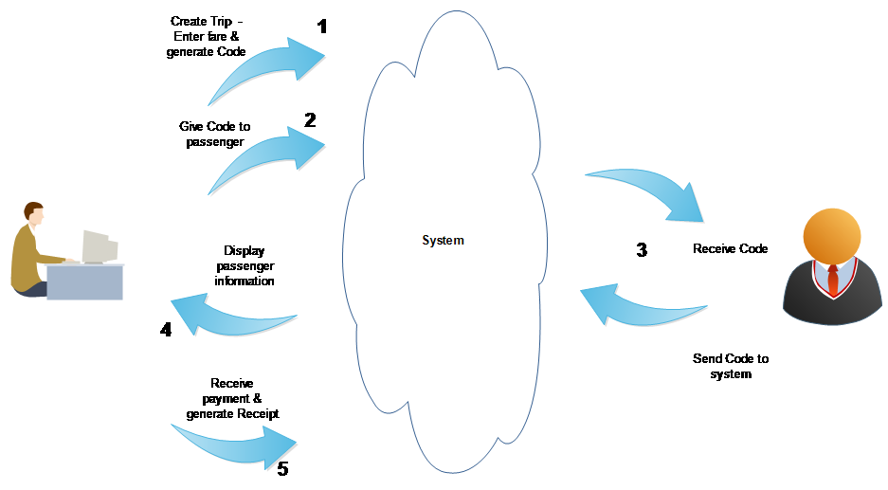
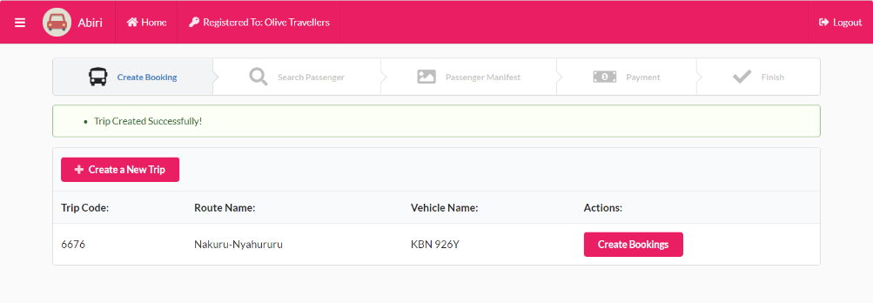
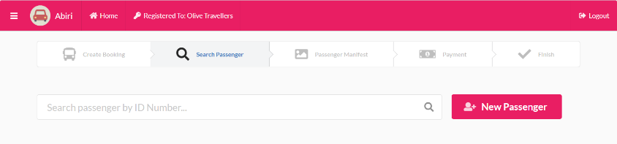
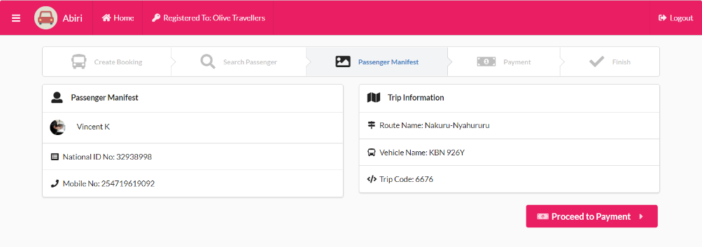
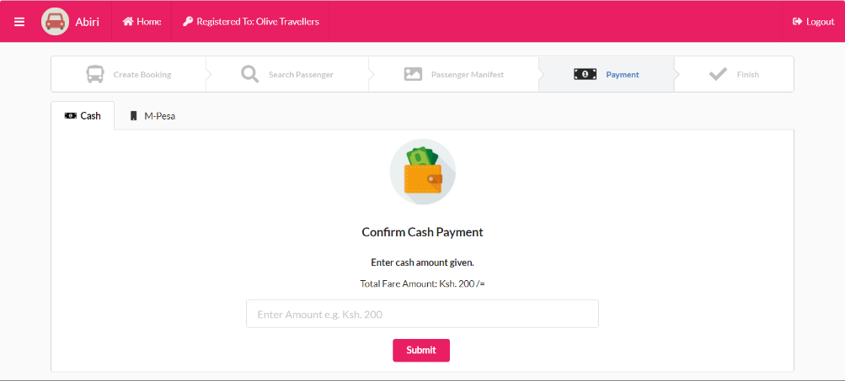
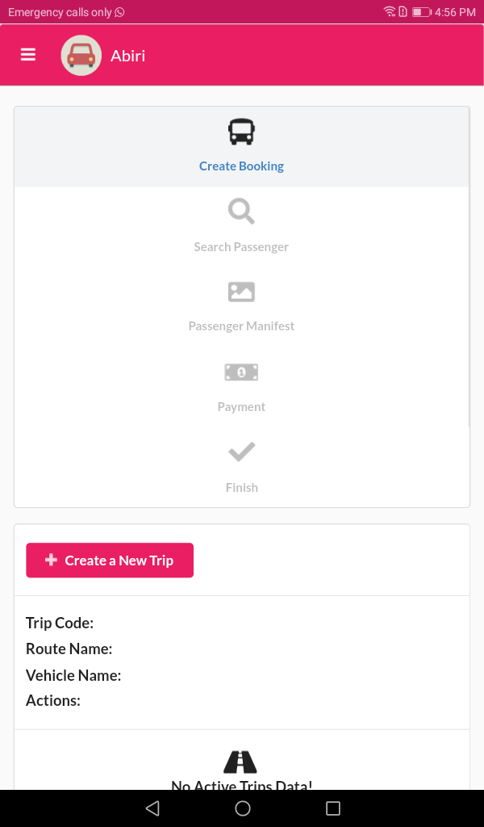
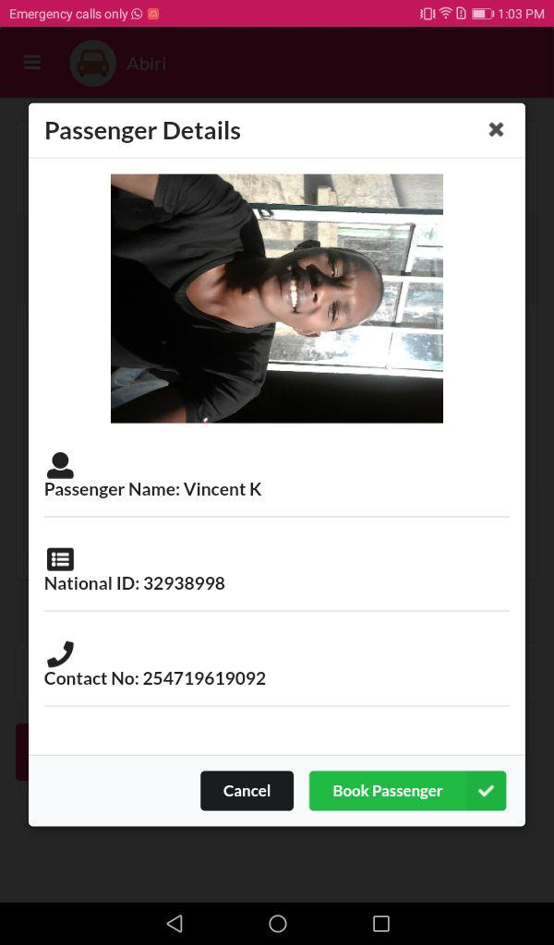
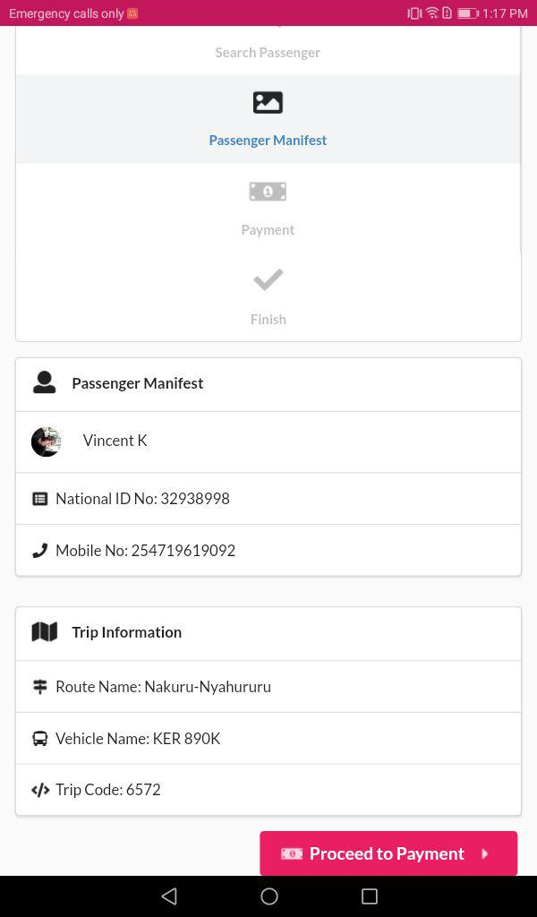
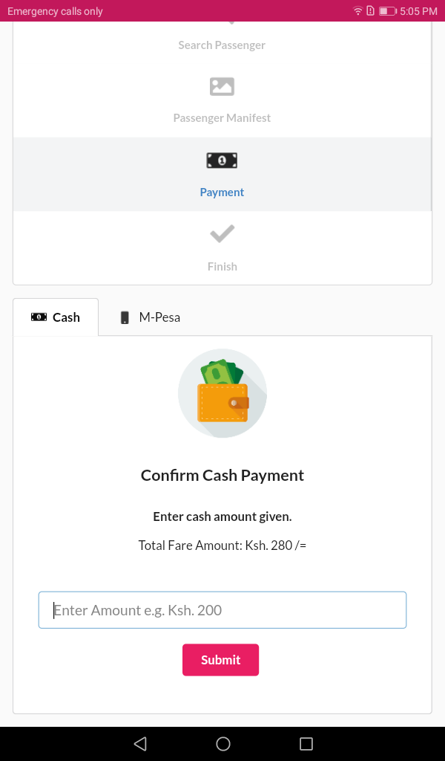
ABIRI: ADDRESSING PASSENGER MANIFEST MANAGEMENT CHALLENGES FOR PUBLIC SERVICE VEHICLES IN KENYA
Kabarak University International Conference on Computing and Information Systems 2018
Moses M Thiga, mthiga@kabarak.ac.ke , Vincent K Chebon, vchebon@kabarak.ac.ke
Kabarak University, Kenya.
Introduction High levels of lawlessness, crime and accidents have over the years plagued the public transport sector in Kenya. Operators are known to hike fares at will (Chitere & Kibua, 2005), hijacking by persons posing as passengers is common in matatus, boda bodas and taxis, (Daily Post Correspondent, 2013; Murage, 2013) and insurance fraud perpetuated by ambulance chasers is common place (Standard Media, 2013). These challenges stem from the lack of properly enforced laws as well as systems. PSV operators are not able to verify the identity of their passengers as well as maintain accurate passenger manifests. In an effort to address these challenges the Kenya government is in the process of introducing amendments to the traffic act to require all public service vehicles to issue tickets to all passengers as well as maintain passenger manifests for long distance travel (Andae & Herbling, 2013). The problem There is a critical lack of a suitable, easy to use and affordable ticketing and passenger manifest system for use by public service vehicles. Existing systems require extensive investment in hardware and software as well as lengthy user training. A majority of PSV operators are thus likely to find it difficult to comply with the provisions of the amended traffic act requiring them to issue tickets and maintain passenger manifests. Objectives of the study The main objective of this innovation was to develop a passenger manifest system that can be accessed using mobile application and web interface. Conceptual Framework Step1- Create a trip: A trip or journey is created using a web interface. A vehicle is selected, a route is specified and the fare payable is indicated. Once these details are captured by the system a random ID code for the particular vehicle and trip is generated by the system and displayed. Step 2 – Share ID code with passenger: The ID code is then given to prospective passengers. Step 3 – Passenger sends ID code: The passenger then sends the ID code to a designated short code or through a USSD menu. Step 4 – System displays passenger details: The system then retrieves the ID details of the passenger and displays them to the PSV operator. Step 5 – Receive payment and produce receipt: The PSV operator then receives the payment and produces a receipt with the full details of the passenger. Methodology The approach being employed is as follows; Mobile application development – This part of the study has progressed significantly and the prototype developed using android is ready for piloting. The web application backend can be accessed on https://abiri.shulemall.com Rapid prototyping approach was developed and evaluated for its potential use in the sector. The approach was found to be convenient given that the users would pay for the development or maintenance of the system progressively and not upfront.
Web Application
The Passenger Manifest Process.
Mobile Application
References
Andae, G., & Herbling, D. (2013). New licensing rules may lock out small matatu, bus owners. Retrieved from http://www.businessdailyafrica.com/New-licensing-rules-may-lock-out-small-matatu-and-bus-owners/-/539546/2005834/-/1tsr51/-/index.html
Chitere, P. O., & Kibua, T. N. (2005). Efforts to Improve Road Safety in Kenya: Achievements and Limitations of Reforms in the Matatu Industry. Retrieved from Nairobi, Kenya:
Daily Post Correspondent. (2013). Passengers along Ngong Road Hijacked. Retrieved from http://www.kenyan-post.com/2013/08/passengers-along-ngong-road-hijacked.html
Murage, G. (2013). Gangsters hijack Gilgil matatu. Retrieved from http://www.the-star.co.ke/news/article-23723/gangsters-hijack-gilgil-matatu
Roberts, M., & Wood, M. (2002). The strategic use of computerised information systems by a micro enterprise. Logistics Information Management, 15(2), 10.
Standard Media. (2013). Standard Digital News - Proposed PSV rule may create cartels. Retrieved from http://www.standardmedia.co.ke/mobile/?articleID=2000094293&story_title=proposed-psv-rule-may-create-cartels
Based on the process above the system is capable of producing a number of reports such as the number and details of passengers on various trips, the total number of trips per vehicle, the total amount of money collected per vehicle, the routes travelled by the vehicle and passenger specific reports such as number of trips and the total spend over a period of time.

