Slide 1
Kabarak University International Conference on Business and Economics 2021
1
Kabarak University International Conference on Business and Economics 2021
EFFECT OF POLITICAL ENVIRONMENT ON SUSTAINABLE GROWTH OF MICRO AND SMALL ENTERPRISES IN NAKURU TOWN, KENYA
Ernest Maina
9/27/2021
Notes:
1

Slide 2
2
Introduction
Sustainable growth of MSEs depend on political environment
Collectivism as a result of a political system - The ‘one village, one product’ approach – works in Japan, Indonesia and Thailand (Oikawa, 2015, p. 84).
Accumulation of income and capital in gulf countries devoid of favorable political environment led to failed MSEs (Amash, 2012, p. 1)..
European countries such as Sweden are an example of the positive influence of political environment (Pourmand 2011, p. 11)
Government programs and policies in Nigeria and South Africa are the most influential to MSEs (Mark and Nwaiwu, 2015, p. 2: Wiese, 2014, p. 40)
International Conference on Business and Economics 2021 9/27/2021

Slide 3
Problem Statement
MSEs contributing only 20% to the GDP with 80% employment rate because of toxic politics, inappropriate policies and regulations, and misalignment of local policies to national interests, county needs and requirements (Ogola, 2020).
Nakuru County - population of more than 2.1 million - one of the most populous counties in Kenya. Ranked third at 35.14 % in enhancing the business environment for MSEs after Nairobi at (65.33%) and Nyandarua at (40.48%)
The study assessed the effect of political environment on sustainable growth of Micro and Small Enterprises in Nakuru town as a geographical area.
International Conference on Business and Economics 2021 9/27/2021

Slide 4
Research Objectives
General Objective of the Study
The general objective of the study will be to assess the effects of the political environment on sustainable growth of MSEs in Nakuru town.
Specific Objectives of the Study
To examine the effects of political stability on sustainable growth of MSEs in Nakuru town.
To determine the effects of government policies & regulations on sustainable growth of MSEs in Nakuru town.
To identify the effects of the political system on sustainable growth of MSEs in Nakuru town.
International Conference on Business and Economics 2021 9/27/2021

Slide 5
Theoretical Review
Political Business Cycle Theory
Governments undertake measures that impact the economy of the country and business based on the period in relation to the election year and electioneering (Frankel, 2010, p. 1439).
Highly evident in economies that have two, or more political parties (Li, 2017, 45)
Real Business Cycle Theory
Fluctuation in business cycles can be accounted for by actual or real shocks that businesses feel as opposed to nominal shocks
Political environment provides some of the nominal and actual shocks.
International Conference on Business and Economics 2021 9/27/2021

Slide 6
Triple Bottom Line Model
The triple bottom-line framework - asserts the idea that a company can be managed to generate capital and profit while improving peoples’ lives and environmental impact.
The triple bottom line frame work consists of three parts:
the social - measures business impact on human capital/ community/ shareholders, stakeholders and employees.
environmental - refers to the environmental sustainability
economic aspects - the impact of an organization on its economic environment.
International Conference on Business and Economics 2021 9/27/2021

Slide 7
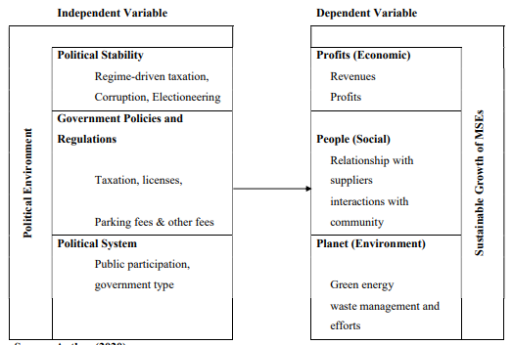
Conceptual Framework
International Conference on Business and Economics 2021 9/27/2021

Slide 8
Research Design
Descriptive research design - aims at determining the frequency of occurrence or the relationship between variables (Erickson, 2017, p. 59).
1260 registered MSEs in Nakuru town as of 2015 (Muiruri, Richu and Karanja, 2015, p. 611).
Assuming the 6.1% growth rate (Kenya National Bureau of Statistics, 2019, p. 22).
Population = 1,338 MSEs.
International Conference on Business and Economics 2021 9/27/2021

Slide 9
Sampling and Data Collection
Sample size = n= Nc2/ (c2+ (N-1) e2) (Nassiuma, 2000)
Sample = 101.9 or 102
Evenly distributed across all industries/sectors.
Structured questionnaire to collect data from the respondents
The pilot study was conducted in Langalanga, Kanu Street area, which has similarly diverse businesses
International Conference on Business and Economics 2021 9/27/2021

Slide 10
Response and Reliability
90% Response rate.
Research tool reliable on all variables per Cronbach’s Alpha score.
International Conference on Business and Economics 2021 9/27/2021

Slide 11
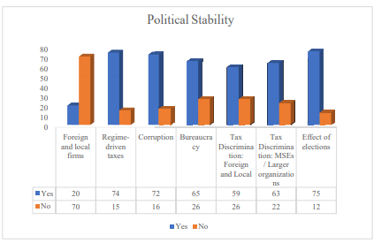
Hypothesis 1: Political Stability
Correlation Analysis
 | Profits | Environment | Relationships
Regime-driven taxation | -0.741 | -0.599 | -0.515
Bureaucracy | -0.721 | -0.465 | -0.631
Electioneering | -0.760 | -0.732 | -0.671
International Conference on Business and Economics 2021 9/27/2021

Slide 12
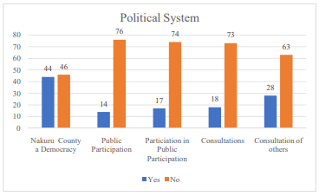
Hypothesis 2: Political System
Correlation Analysis
 | Profits | Environment | Relationships
Democracy | 0.642 | 0.612 | 0.736
Effective Public Participation | 0.495 | 0.472 | 0.526
Public Participation attendance | 0.443 | 0.544 | 0.492
International Conference on Business and Economics 2021 9/27/2021

Slide 13
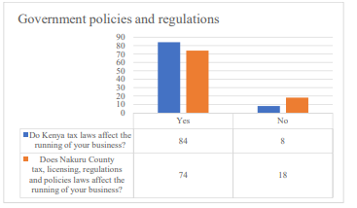
Hypothesis 3: Government Policies and Regulations
Correlation Analysis
 | Profits | Environment | Relationships
Taxation | -0.624 | -0.578 | -0.515
Environmental. Regulation | -0.624 | -0.578 | -0.515
Licensure/ Parking | -0.620 | -0.578 | -0.515
Health/other regulation | -0.524 | -0.628 | -0.495
International Conference on Business and Economics 2021 9/27/2021

Slide 14
Summary of Findings & Conclusions
Political environment is a significant factor in sustainable growth of MSEs in Nakuru town, Nakuru county and the country at large.
Negative correlation between all aspects of political stability and all aspects of sustainability - Increase in any of these aspects would reflect worsening business sustainability
Positive correlation between all aspects of political system and all aspects of sustainability - Increase in any of these aspects would reflect enhanced business sustainability
Negative correlation between all aspects of political stability and the aspects of sustainability- Increase in any of these aspects would reflect worsening business sustainability
International Conference on Business and Economics 2021 9/27/2021

Slide 15
Recommendations
Reduction and eradication of multiple taxation
Involving small businesses in formulating policies in Nakuru County.
Implementation of policies and regulations supported by local government owners.
The electioneering period should also be enhanced to ensure that the services that MSEs need are not disrupted
Sufficient protection and security for their businesses during electioneering.
Stability in taxations and regulations that are regime-based.
International Conference on Business and Economics 2021 9/27/2021

Slide 16
THE END
THANK YOU
International Conference on Business and Economics 2021 9/27/2021

